Slide 1
DATA SCIENCE on Microsoft Azure
Created by
Mouafek Ayadi
Notes:
https://slidesgo.com/theme/data-science-consulting

Slide 2
Content
01. What is Data Science?
02. Some DS use cases
03. AML services
04. ML Pipelines
05. E2E ML
06. Compute
07. MLOPS
08. Security
09. Fair Learning
10. Kahoot

Slide 3
What is Data Science?
Computer Science
Business Knowledge
Artificial Intelligence
Mathematics
Software Engineering
Domain Expertise
Machine Learning
Probability & Statistics

Slide 4
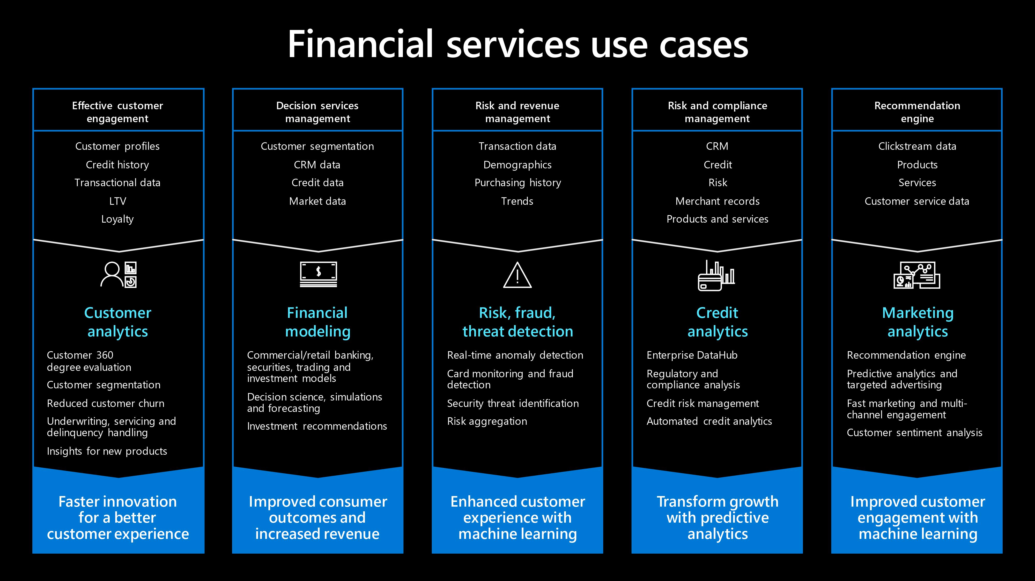

Slide 5


Slide 6
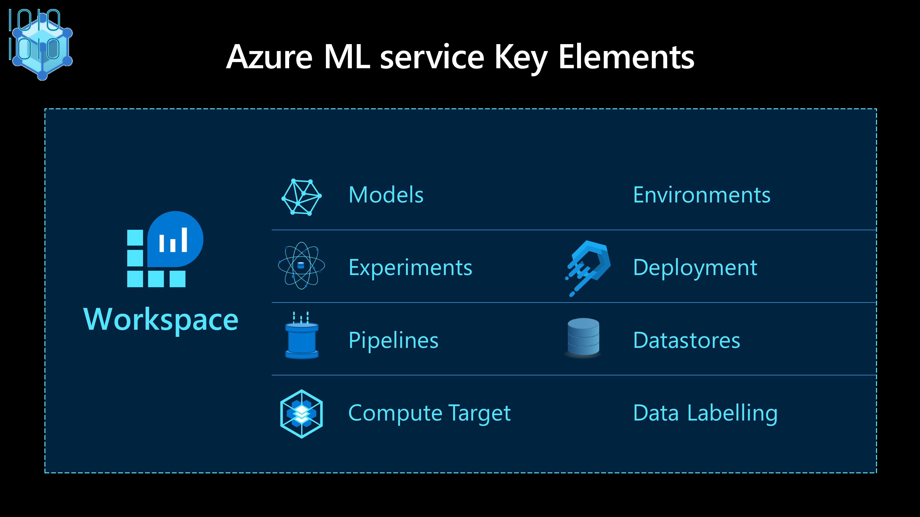

Slide 7
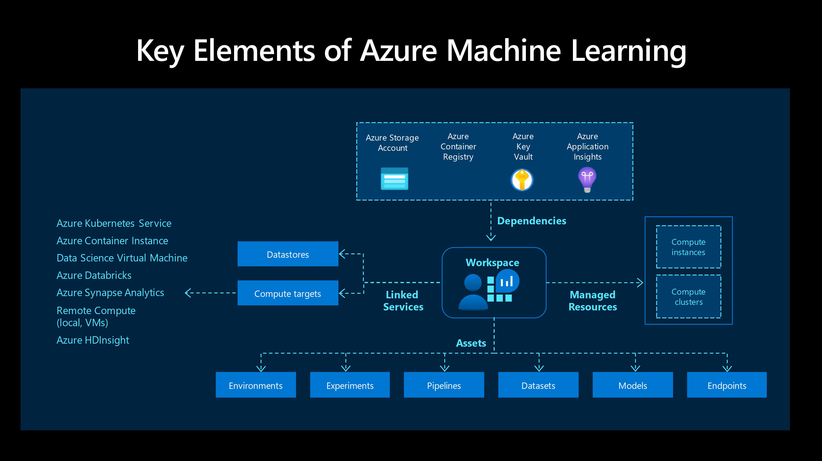

Slide 8
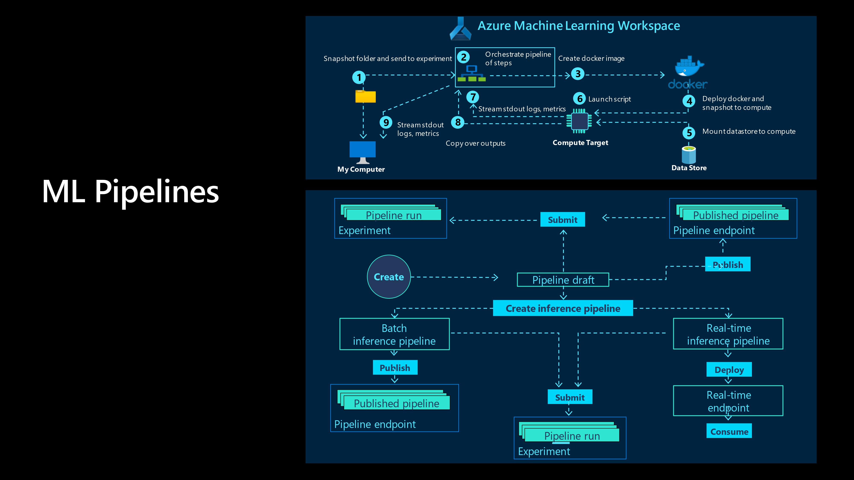

Slide 9
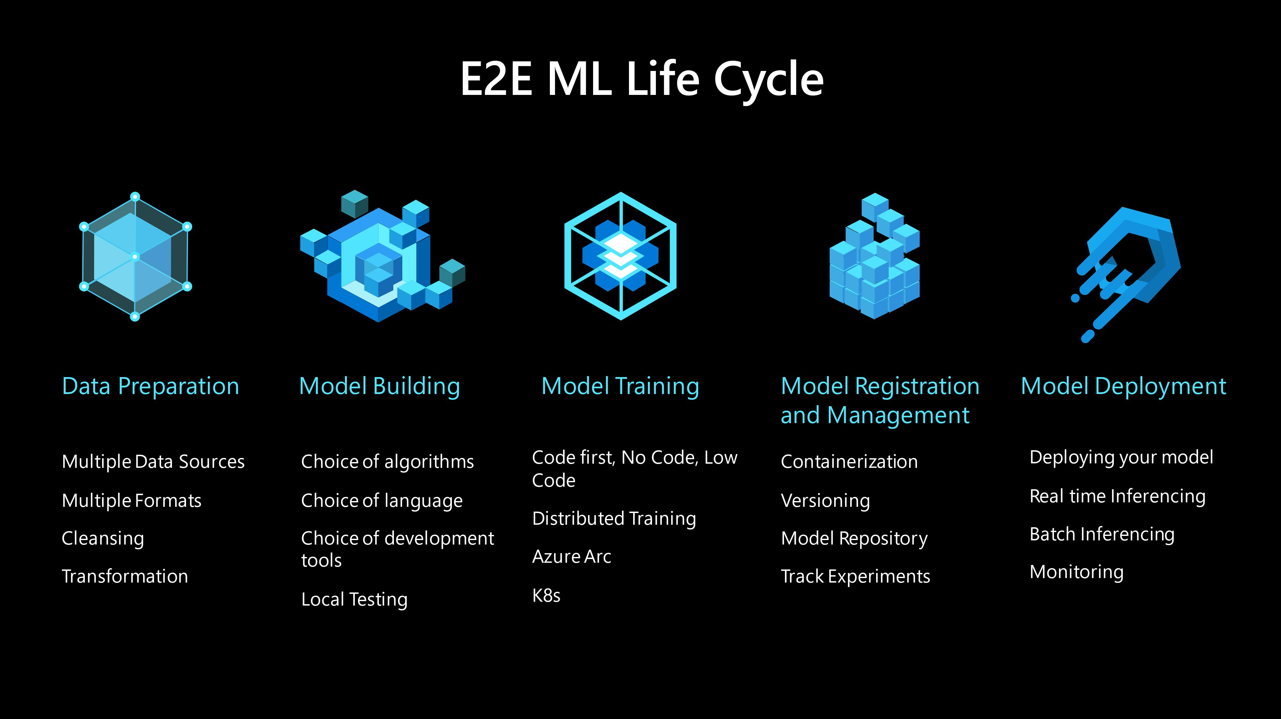

Slide 10
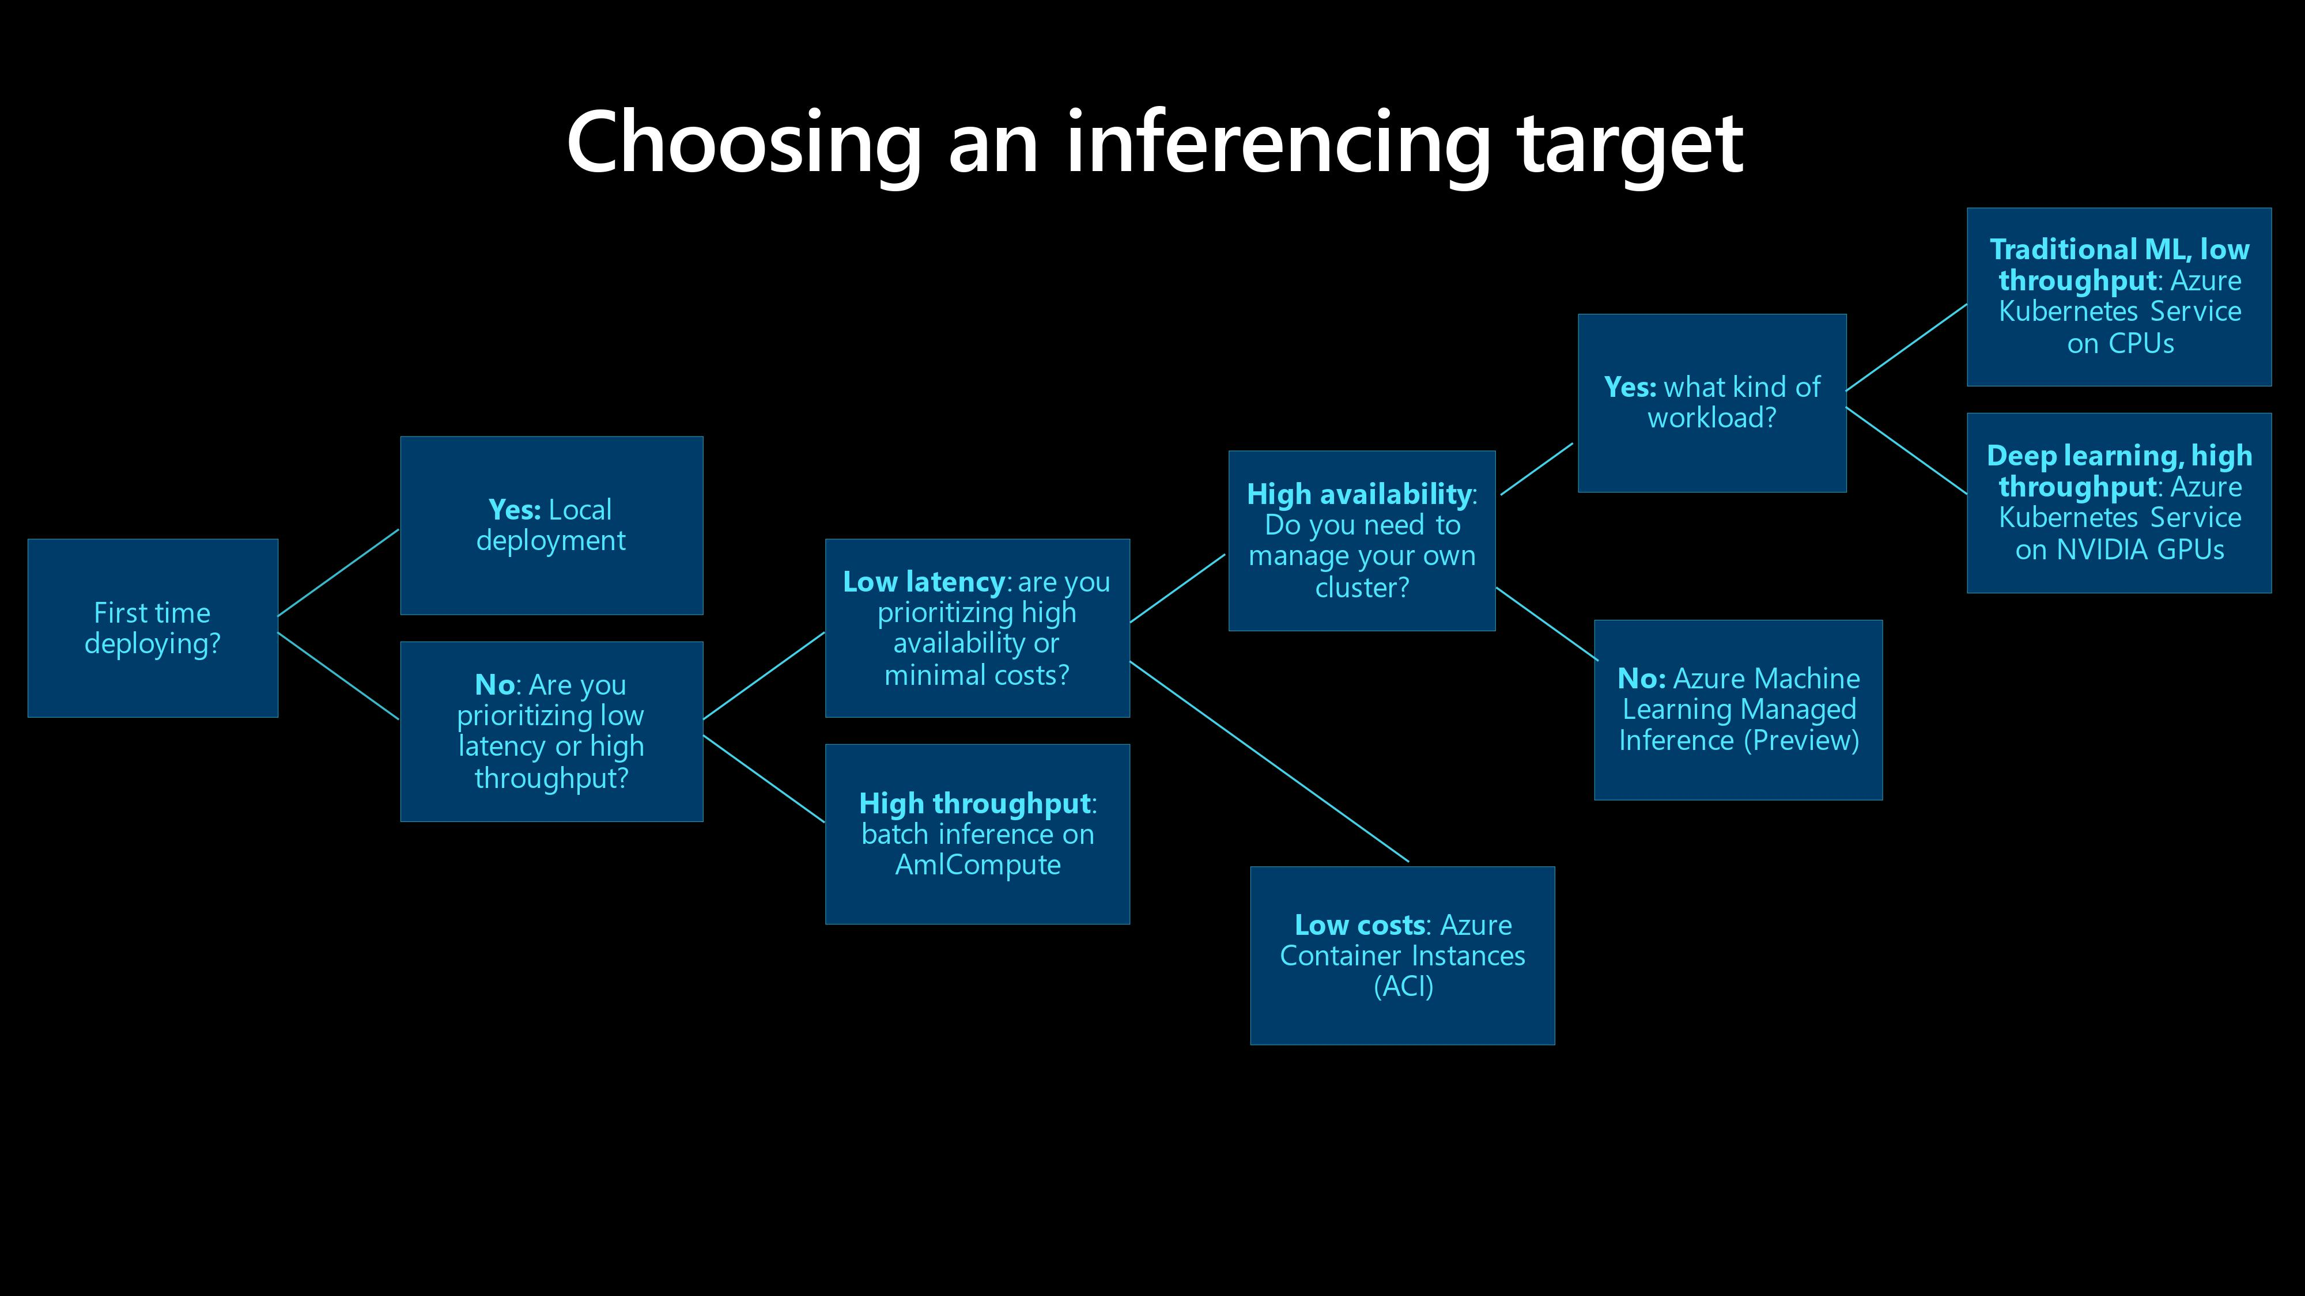

Slide 11
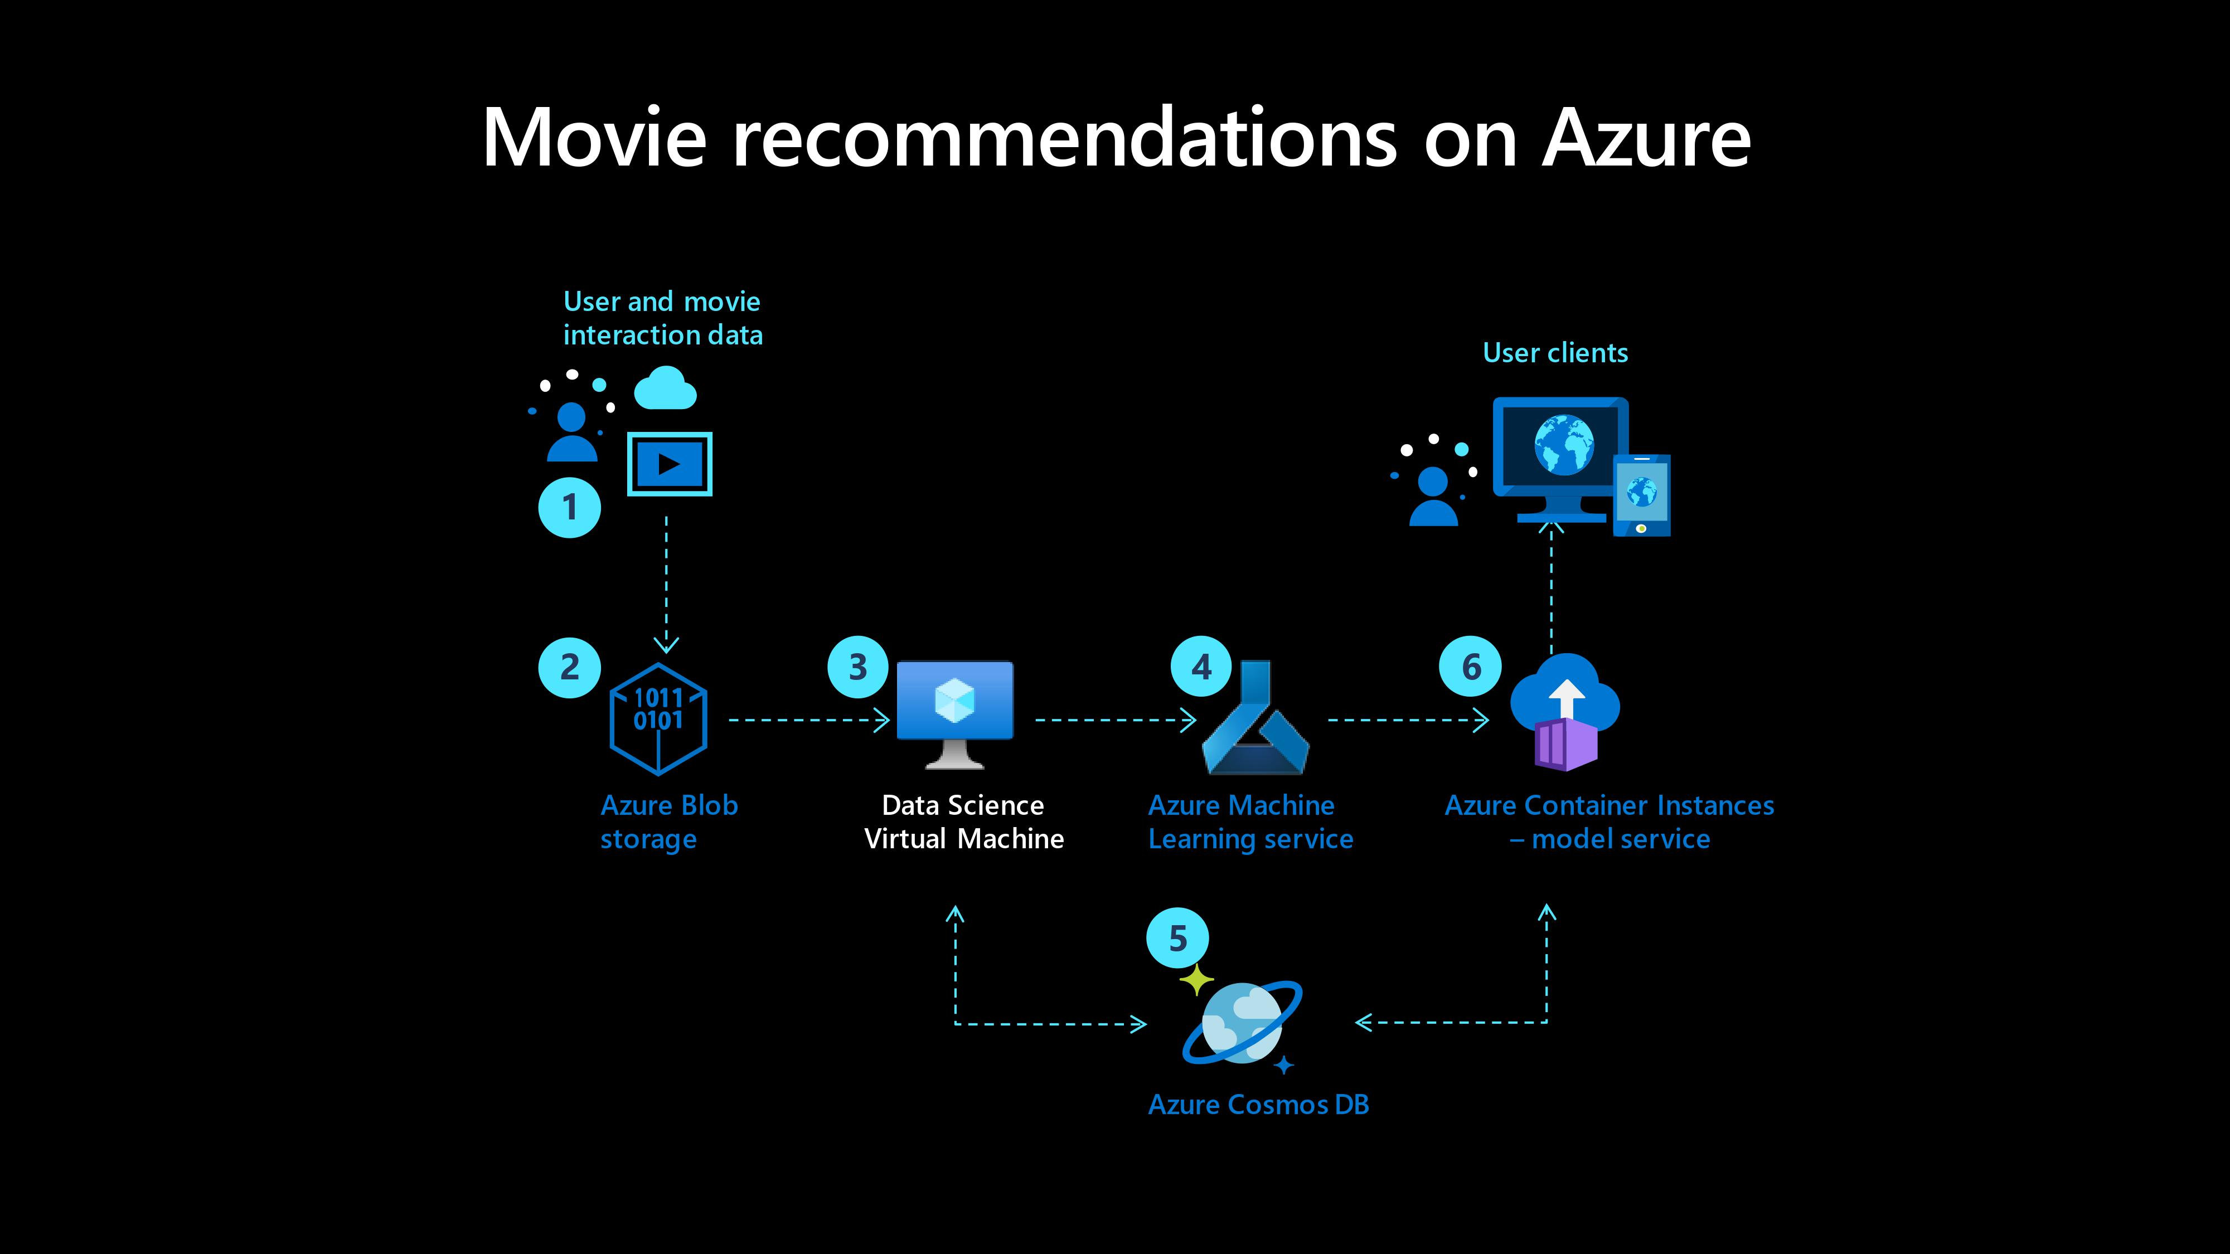

Slide 12
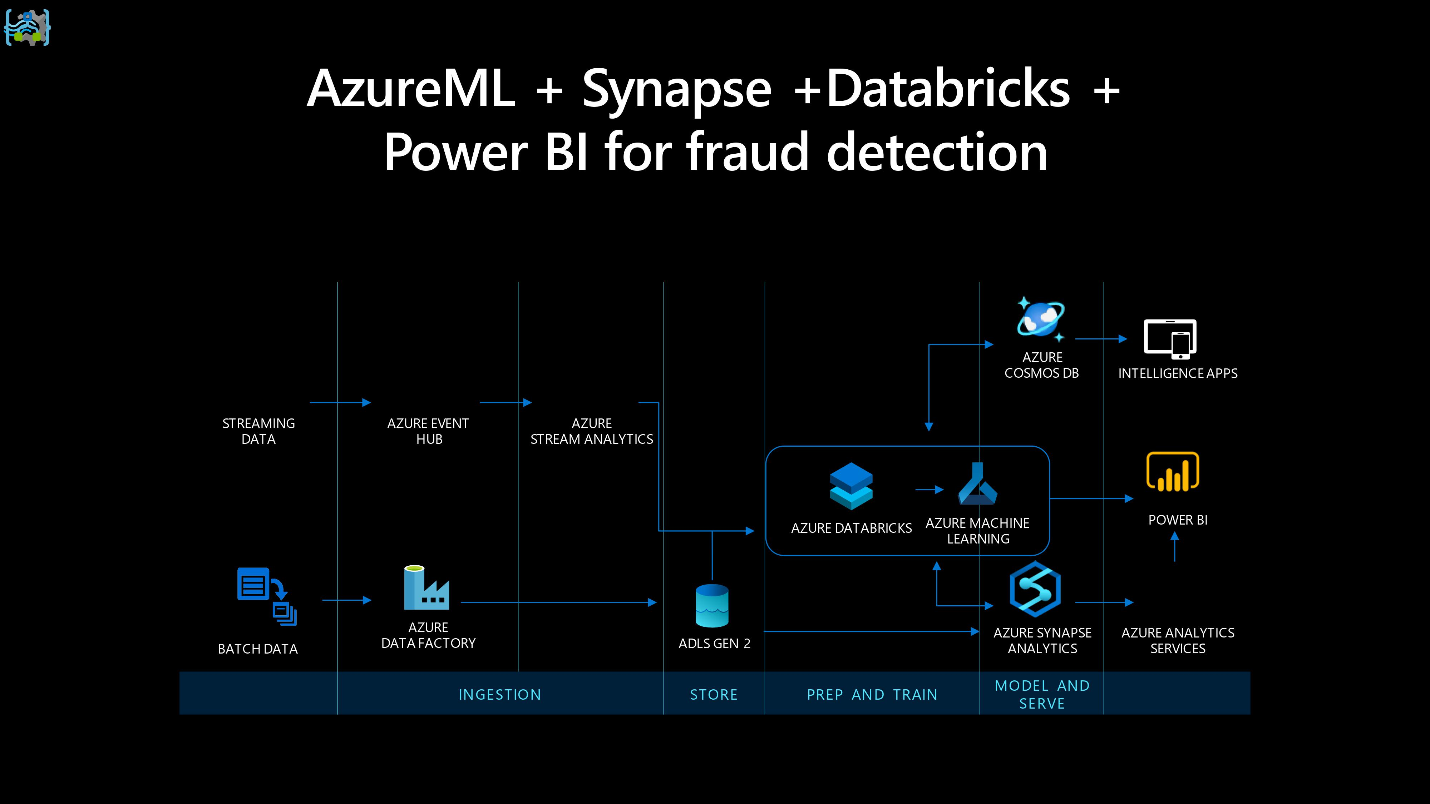

Slide 13
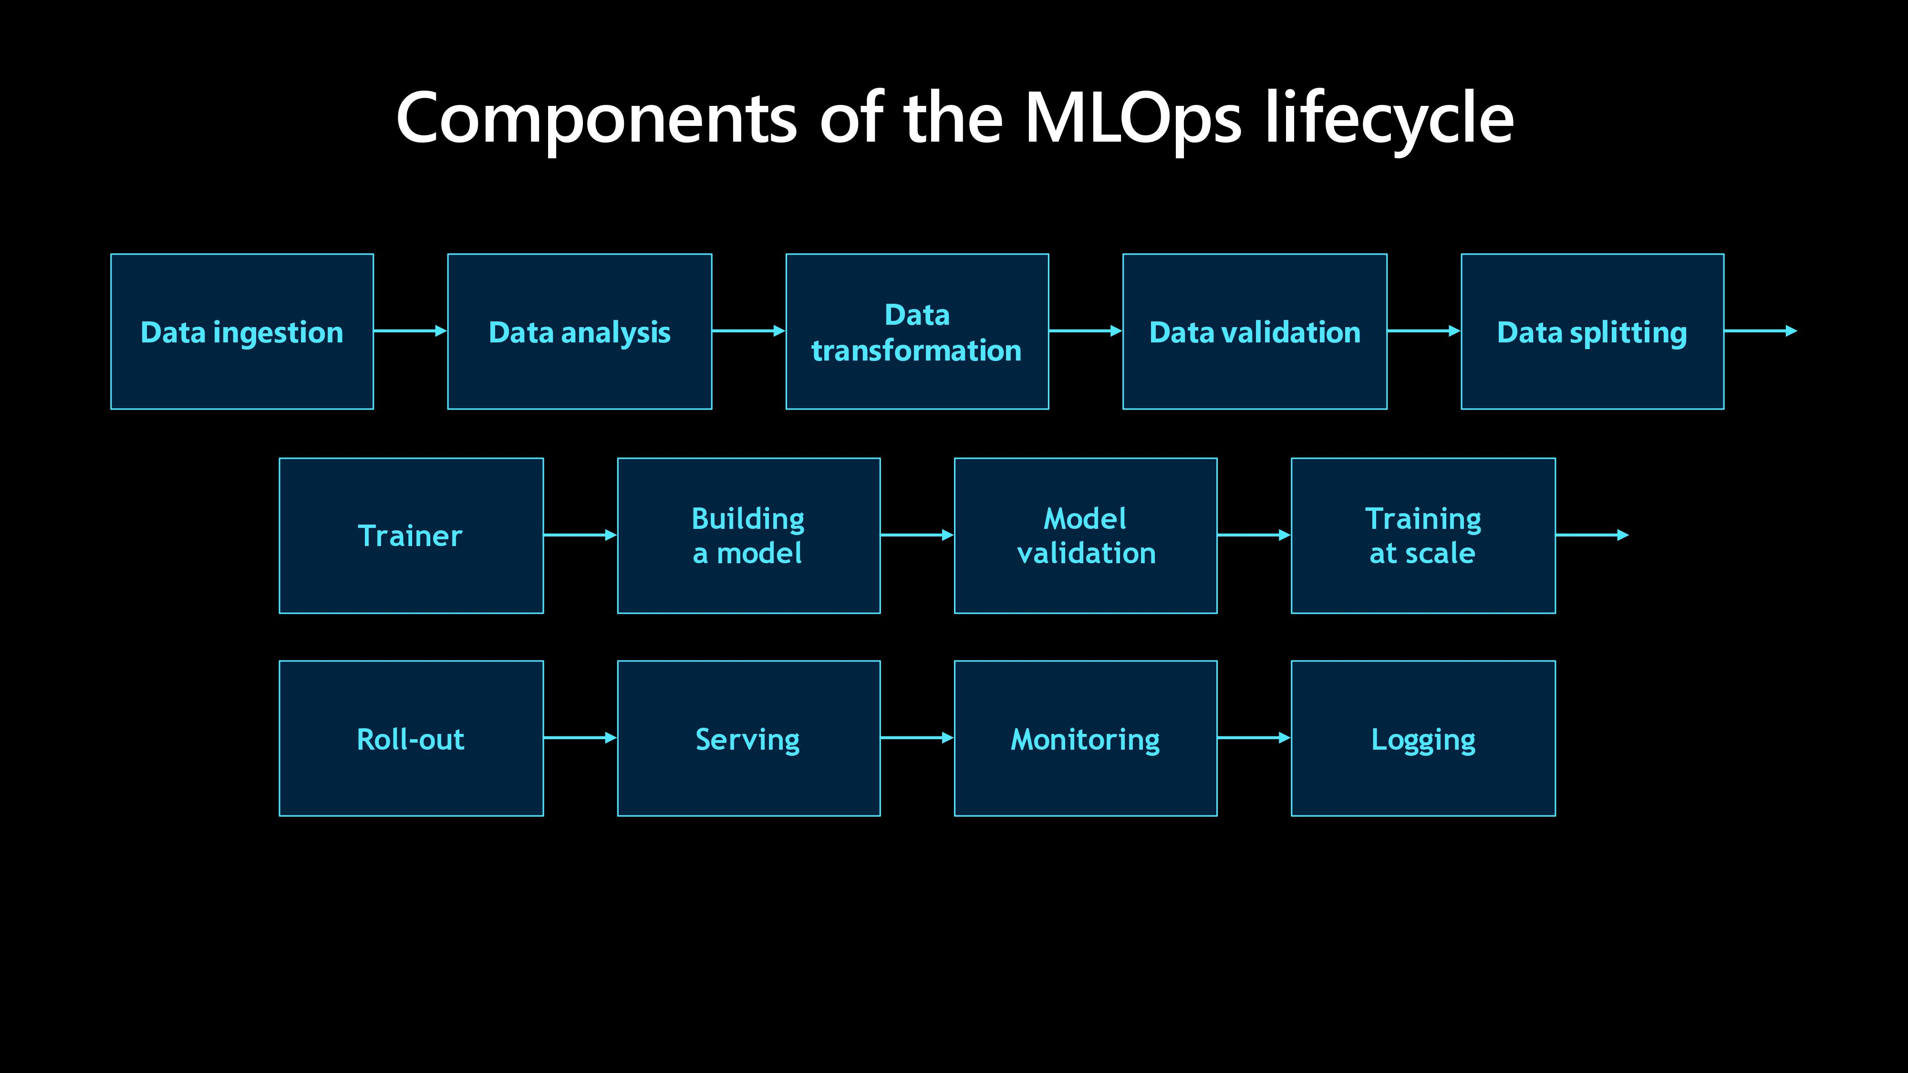

Slide 14
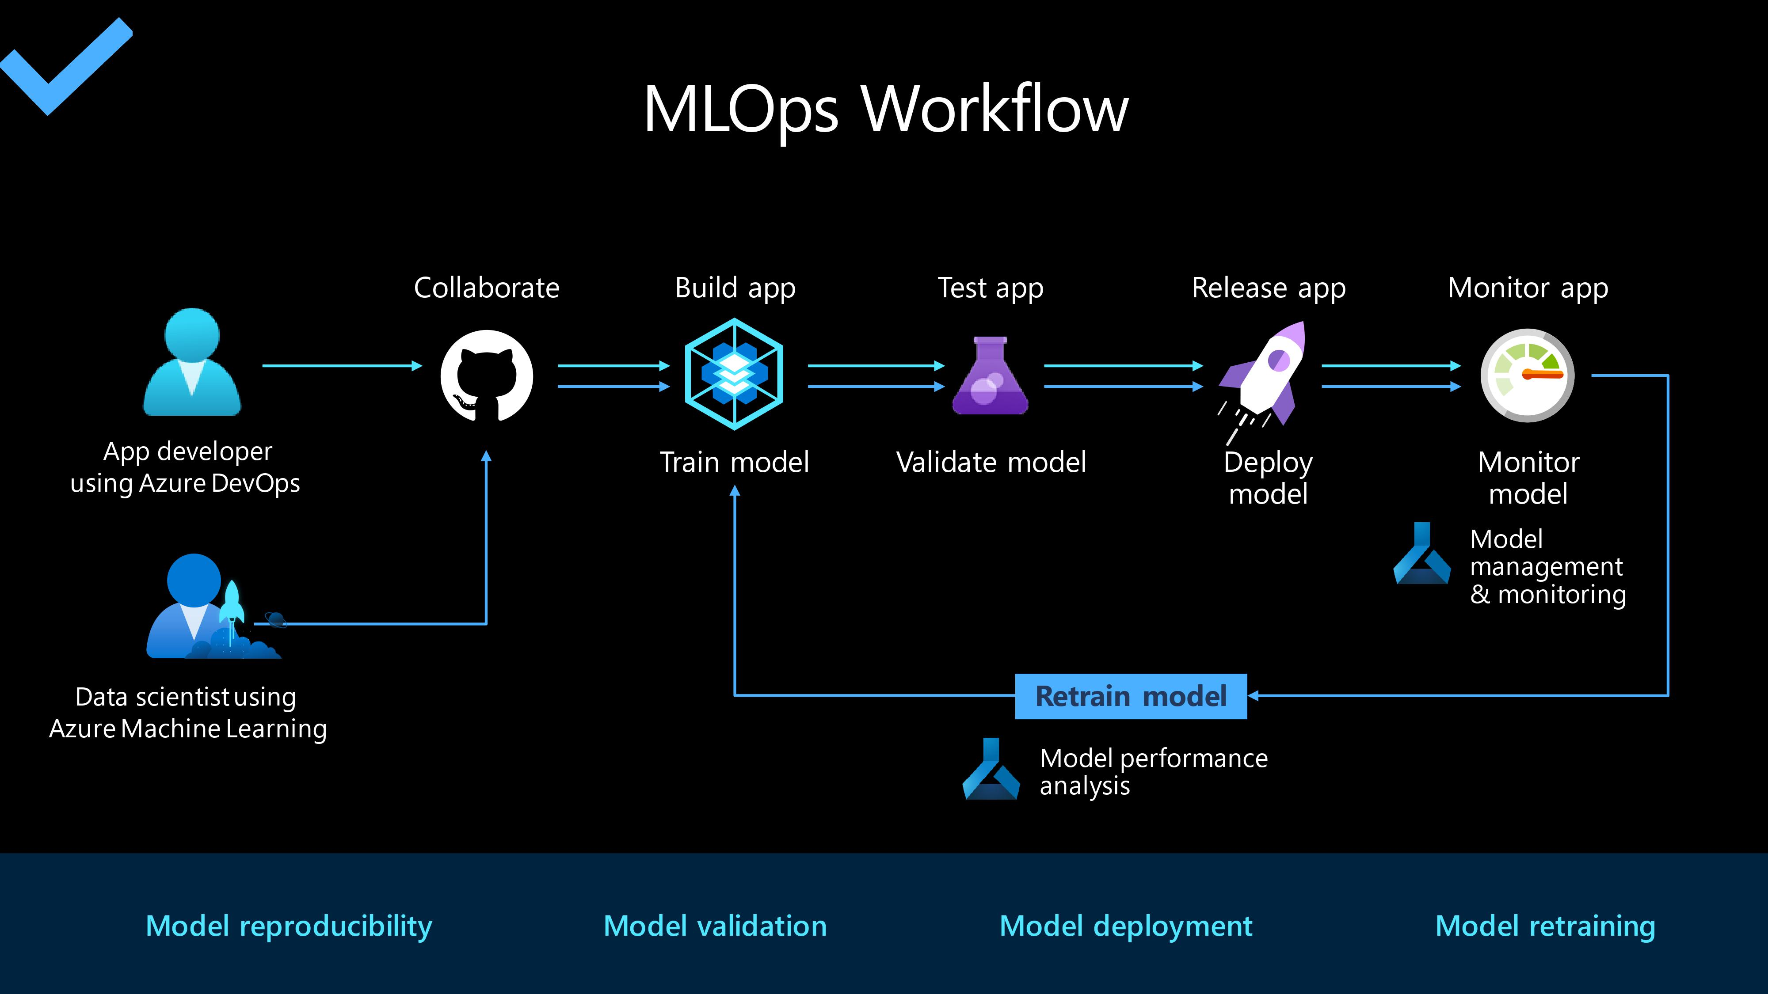

Slide 15
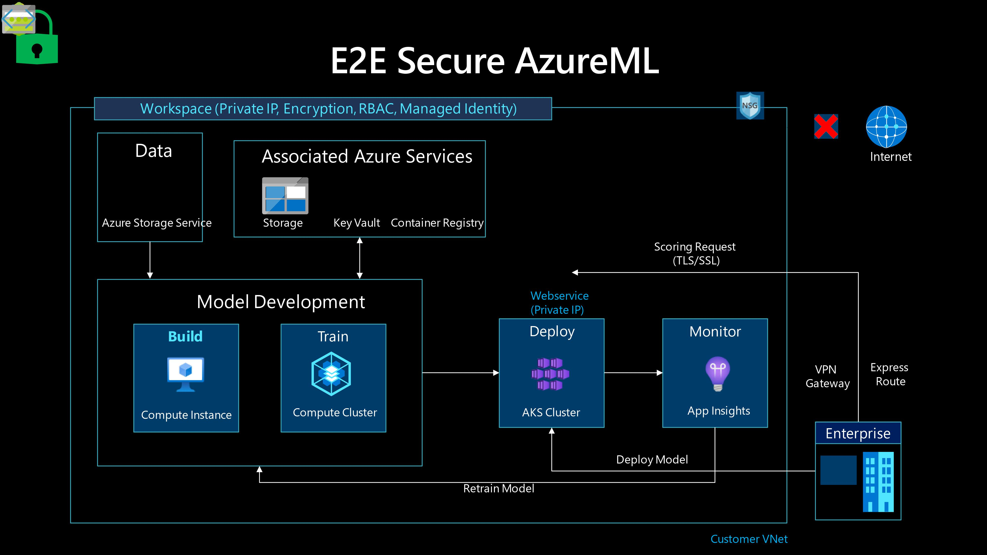

Slide 16
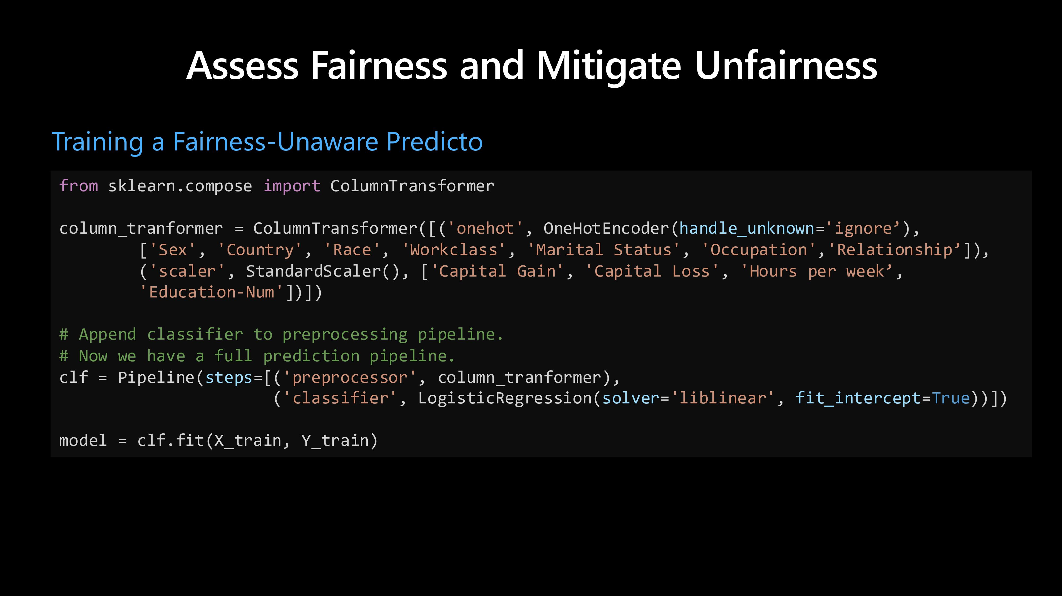

Slide 17
THANKS
Do you have any questions?
https://www.linkedin.com/in/mouafek-ayadi/

